Slide 2
Thyroid nodules and cancer in children
Dr. Mosallanejad
Pediatric Endocrinologist ,Shahid Beheshti University of Medical science

Slide 3
Thyroid nodules and cancer
Benign lesions — The majority of thyroid nodules in children are benign :adenomas
thyroid cysts, and inflammatory lesions
Malignant thyroid tumors —
●Differentiated thyroid cancers (DTCs)
•Papillary thyroid cancer (PTC) –accounts for approximately 86 percent of pediatric thyroid cancers
•Follicular thyroid cancer (FTC) –accounts for 8 to 9 percent of pediatric thyroid cancers
●Medullary thyroid cancer (MTC) –accounts for 4 percent of pediatric thyroid cancers Most cases are associated with multiple endocrine neoplasia type 2 (MEN2)
●Other – Other types of thyroid cancers, are rare in children, are anaplastic thyroid carcinoma, primary thyroid lymphoma, and cancers that have metastasized to the thyroid

Slide 4
Although the majority of nodules are benign, children with thyroid nodules are more likely to have cancer than adults

Slide 5
Approach to Thyroid Nodules History and physical examination
Most thyroid nodules in children are initially discovered either by the patient, parent, or clinician
●Past medical history of head and neck radiation
●Questions about features of thyroid cancer syndromes, such as developmental delay or autism
●Family history for autoimmune thyroid disease, thyroid cancer, and other features associated with thyroid cancer syndromes, such as endocrine tumors, gastrointestinal polyps, or other early-onset cancers

Slide 6
thyroid cancer syndromes
APC (adenomatous polyposis coli) syndrome
DICER1 syndrome
Multiple endocrine neoplasia type 2 (MEN2)
PTEN (phosphatase and tensin homolog) hamartoma tumor syndromes (including Cowden and Bannayan-Riley-Ruvalcaba syndromes)
Werner syndrome
Carney complex

Slide 7
thyroid cancer syndromes
• APC (adenomatous polyposis coli), including Gardner syndrome: familial adenomatous polyps in the gastrointestinal tract and a predisposition to papillary thyroid cancer (PTC) and several other tumors
DICER1 syndrome :pleiotropic tumors including pleuropulmonary blastoma, cystic nephroma, ovarian Sertoli-Leydig cell tumors, pineal tumors, and nasal chondromesenchymal hamartomas
Most thyroid cancers in individuals with DICER1 syndrome are FTC or follicular variants of PTC
•Multiple endocrine neoplasia type 2 (MEN2) is strongly associated with medullary thyroid cancer (MTC) These disorders are caused by mutations in the RET protooncogene

Slide 8
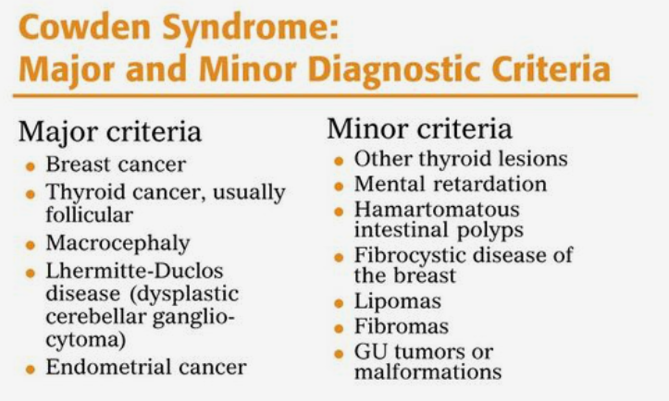
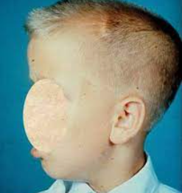
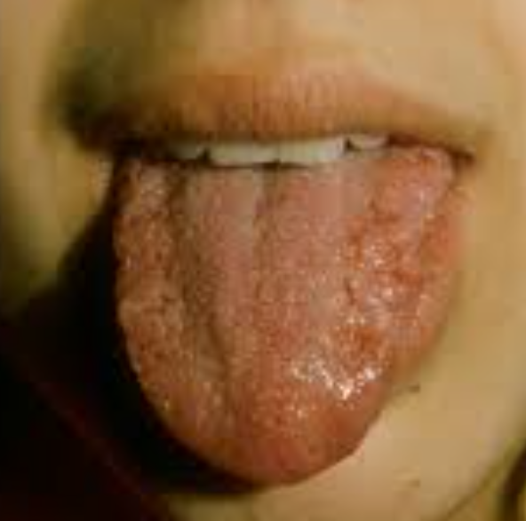
PTEN (phosphatase and tensin homolog) hamartoma tumor syndromes (including Cowden and Bannayan-Riley-Ruvalcaba syndromes) are characterized by hamartomas in the skin and other tissues and an increased predisposition to differentiated thyroid cancer (DTC Clinical features associated with PTEN gene mutations in pediatric patients are macrocephaly, autism or developmental delay, vascular malformations, and penile freckling

Slide 9
Werner syndrome is characterized by connective tissue disease, causing symptoms of premature aging (progeria) and increased risk for osteosarcoma, soft tissue sarcomas, melanoma, and PTC or FTC

Slide 10
Carney complex type 1 is characterized by a primary pigmented nodular adrenocortical disease, other endocrine tumors including PTC or FTC, and nonendocrine tumors such as myxomas and breast adenomas a mutation in The PRKAR1A gene

Slide 11
physical examination :
●Inspection and palpation of the thyroid gland, whether it is symmetric, whether it is cystic or firm, whether it is tender
●Careful examination of the lateral neck should be undertaken for lymph nodes:
•Mobile, rubbery lymph nodes under the mandible (level II) are common and usually benign
•Ipsilateral, firm, immobile lymph nodes in the lower neck (levels III and IV) are suspicious for malignancy
●general examination should be carried out for findings associated with the genetic thyroid cancer syndromes

Slide 12
EVALUATION OF THYROID NODULES
thyroid function tests
thyroid scintigraphy
ultrasound
fine-needle aspiration (FNA)

Slide 13
Hyperfunctioning ("hot") nodules
Combination of low thyroid-stimulating hormone (TSH) and radioisotope scan showing focal uptake of [123-I] in the nodule with suppressed uptake in the rest of the gland
A serum TSH <0.3 mIU/L at the time of scintigraphy generally ensures that uptake is suppressed in the surrounding thyroid tissue
children with borderline low TSH in whom an autonomous nodule is suspected can be treated with levothyroxine (50 to 75 mcg daily) for one to two weeks to suppress TSH further prior to scintigraphy
The majority of hyperfunctioning nodules are benign, and FNA generally is not required

Slide 14
Rarely, a hyperfunctioning nodule may harbor papillary thyroid cancer (PTC) or follicular thyroid cancer (FTC) ,so FNA should be considered in the presence of atypical features such as solid parenchyma or abnormal lymph nodes on ultrasound or extrathyroidal uptake on scintigraphy
However, because these adenomas are unlikely to resolve spontaneously, surgical excision is often pursued, particularly if symptoms are present
Radioactive iodine ablation of the toxic adenoma is an option in older adolescents
For patients who have overt hyperthyroidism but do not desire surgery or ablation, a low dose of methimazole may be used

Slide 15
Lexicon of US Descriptors of Thyroid Nodules
US Descriptor | Definition
Composition | Solid Completely or nearly completely soft tissue Cystic Completely fluid filled Spongiform Tiny cystic spaces occupy most of the nodule
Echogenicity | Hyperechoic Isoechoic Hypoechoic Markedly hypoechoic
Calcifications | Microcalcifications Punctate “dotlike” foci without posterior acoustic artifacts; <1 mm in diameter Macrocalcifications Larger and with posterior acoustic shadowing Comet-tail artifacts Triangular reverberation artifact with decreasing width of deeper echoes

Slide 16
Lexicon of US Descriptors of Thyroid Nodules (con.)
US Descriptor | Definition
Margin | Irregular Spiculated, jagged, or sharp-angled border, with or without soft-tissue protrusions into the parenchyma Lobulated Rounded soft-tissue protrusions in the border, with extension into the parenchyma; may vary in quantity (single or multiple) and size (microlobulations) Ill-defined Nodule border is indistinguishable from the thyroid parenchyma Halo Peripheral hypoechoic rim forming the nodule border; can be partial or complete; thickness may be uniformly thin or thick or may be irregular Extrathyroid extension Nodular extension through the thyroid capsule
Shape | Wider Anteroposterior to horizontal diameter ratio of <1 Taller Anteroposterior to horizontal diameter ratio of >1

Slide 17
Lexicon of US Descriptors of Thyroid Nodules(con.)
US Descriptor | Definition
Lymph nodes | Normal Not enlarged; preserved fatty hilum Abnormal Increased size, rounded shape, irregular margins, internal calcifications, heterogeneous echotexture, or cystic change; less characteristic when loss of only the hyperechoic fatty hilum
Vascularity | Absence of nodular Doppler signal ... Increased peripheral vascularization of the nodule ... Increased peripheral and intranodular vascularization

Slide 18
Ultrasonographic features that are associated with an increased risk of thyroid cancer
Irregular margins
Nodule is taller than wide (in transverse view)
MicroCalcifications
Abnormal lymph nodes present
Enlargement of nodule over time In any child with a thyroid nodule, images should also be obtained to assess the morphology of the cervical nodes Benign nodes are elongated with a fatty hilum, whereas abnormal nodes may be rounded, lack a fatty hilum, or contain calcifications or cystic spaces

Slide 19
Fine-needle aspiration
FNA is the most useful test to differentiate benign thyroid nodules from cancer
FNA has high diagnostic accuracy in children
However, the size criteria for performing FNA in adults (≥1 to 1.5 cm) may not be appropriate in a growing child whose thyroid gland may normally be one-half the size of that of an adult
American Thyroid Association Task Force recommends that ultrasound characteristics and clinical context should be used rather than size alone to identify nodules that warrant FNA

Slide 20
"FNA” Indication
FNA biopsy in children on nodules with the following characteristics:
●Nodules ≥1 cm (palpable or nonpalpable) that are solid or mixed cystic/solid
●Nodules <1 cm with ultrasound characteristics that are highly suspicious for cancer, such as calcifications or abnormal cervical lymph nodes, particularly in individuals at increased risk of malignancy (such as history of irradiation)
●Nodules with documented enlargement on repeat ultrasound examinations
Ultrasound guidance should be used for FNA of thyroid nodules in children

Slide 21
The Bethesda System for Reporting Thyroid Cytopathology (BSRTC), initially developed to classify FNA results in adults, should also be used for children
FNA results in the BSRTC fall into six categories
Malignancy rates in intermediate cytologic categories (III, IV, and V) are higher in children than in adults

Slide 22
Nondiagnostic or unsatisfactory (BSRTC category I)
repeat FNA
If the repeat FNA is still nondiagnostic, surgical lobectomy should be considered
Percentage of FNA cases falling in this category: 10-15%
There is no level 1 evidence regarding the optimum interval for a repeat aspiration
A 3 month interval has been suggested to prevent false-positive misinterpretations due to reactive/reparative changes

Slide 23
Benign (BSRTC category II)
should be followed clinically
Percentage of FNA cases falling in this category: 40-60%
• Colloid nodule/follicular nodule/multinodular goitre
• Cyst
• Diffuse hyperplasia (Graves disease)
• Lymphocytic thyroiditis (Hashimoto)
• Acute thyroiditis
• Granulomatous thyroiditis
The optimal interval and duration of ultrasound monitoring for benign nodules in children are unknown
initial repeat ultrasound in one year and subsequent surveillance every one to two years (or longer if significant changes are not observed). A significant increase in nodule size (increase in volume by ≥50 percent, or increase in diameter by ≥20 percent and by at least 2 mm in at least two dimensions) should prompt a repeat FNA
Because of their increased risk of false-negative FNA (up to 15 percent), nodules >4 cm should be considered for resection
Benign nodules may also be resected if they cause symptoms

Slide 24
Atypical cells of undetermined significance or follicular lesion of undetermined significance (BSRTC category III)
This category carries a 30 to 45 percent risk of thyroid cancer
Repeat FNA in three to six months
However, some clinicians and families prefer to proceed directly to surgical lobectomy for nodules with BSRTC category III cytology
In this category, the descriptors "indeterminate” and “follicular lesion of undetermined significance" are equally acceptable and can be used interchangeably and appropriately

Slide 25
Follicular neoplasm (BSRTC category IV)
–Percentage of FNA cases falling in this category: ~10%
Risk (30 to 70 percent) of thyroid cancer, often follicular carcinoma or follicular-variant papillary carcinoma
surgery (lobectomy) is generally recommended
For nodules in BSRTC category III or IV, another option is to undertake further evaluation of the FNA specimen for somatic mutations by genetic testing
While genetic testing platforms developed for adults have limited applicability in children
At present, the gene classifier panels that help to predict benign lesions have not been validated in children, so do not recommend

Slide 26
Suspicious for malignancy (BSRTC category V)
●Risk of thyroid cancer is 70 to 85 percent
Children with this result should undergo surgery
Practical issues, problems and suggestions for ancillary testing
a. A repeat FNA may be appropriate to provide more conclusive evidence of malignancy and material for a cell block for ancillary studies
b. In selected cases other investigations (ie serum calcitonin assay for suspected medullary carcinoma) may be recommended
c. In cases where there is a suspicion of lymphoma, a repeat FNA with a recommendation for flow cytometry may establish a definitive diagnosis

Slide 27
Malignant (BSRTC category VI)
– This result is diagnostic of thyroid cancer and should be treated with thyroidectomy

Slide 29
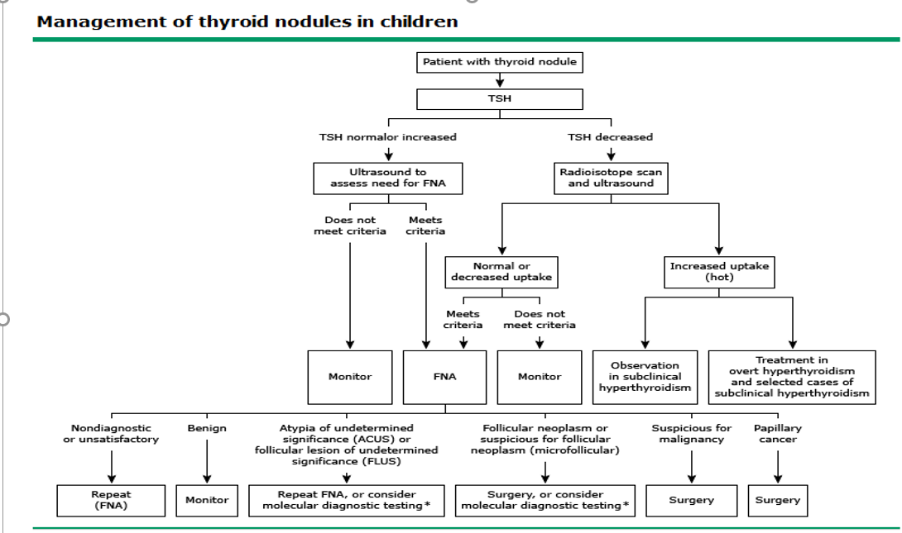

Slide 30
Initial evaluation, treatment, and follow-up of the pediatric thyroid nodule. ATA GUIDELINES

Slide 31
Are There High-Risk Groups Who Might Benefit from Prospective Screening for Thyroid Nodules and Thyroid Cancer?
Several risk factors are associated with the development of thyroid nodules in children, including iodine deficiency, prior radiation exposure, and several genetic syndromes
Thyroid nodules, many of which can only be detected by US, develop in cancer survivors at a rate of about 2% annually and reach a peak incidence 15–25 years after exposure
Insufficient data exist to determine if early detection of nonpalpable tumors will significantly improve the quality of life in patients screened by a standardized protocol using US and fine-needle aspiration (FNA)

Slide 32
An annual physical examination is recommended in children at high risk for thyroid neoplasia
Additional imaging should be pursued if palpable nodules, thyroid asymmetry, and/or abnormal cervical lymphadenopathy are found on examination

Slide 33
Routine use of LT4 therapy for children with benign thyroid nodules?
In general, the data support the efficacy of LT4 therapy to reduce the size and risk of subsequent nodule formation, but there are no data to weigh this potential benefit against the potential risks of long-term suppression therapy
In patients with compressive symptoms or a history of radiation exposure the benefits of LT4 therapy may be more apparent

Slide 34
Follicular thyroid cancer
FTC represents approximately 8 to 9 percent of DTC in children
In contrast with PTC, FTC tends to be unifocal; it typically occurs in nodules with FNA cytology in BSRTC III or IV
FTC is more common in patients with PTEN hamartoma syndrome or DICER1 syndrome

Slide 35
Medullary thyroid cancer
Total thyroidectomy is the treatment of choice for children with medullary thyroid cancer (MTC)
For pediatric patients without MTC but with a high risk for developing MTC because of RET gene mutations, "prophylactic" total thyroidectomy is recommended during infancy or early childhood
The recommended age of "prophylactic" thyroidectomy in asymptomatic RET gene-positive infants or children is based on their risk level, which correlates with the specific RET mutation
In patients with highest-risk mutations (multiple endocrine neoplasia type 2B [MEN2B]), thyroidectomy is recommended during the first year of life
While awaiting the recommended age for thyroidectomy, patients with high- or moderate-risk RET gene mutations can be monitored by thyroid ultrasound and serum calcitonin measurements
If ultrasound discloses a thyroid nodule or worrisome lymph nodes, the diagnosis can be confirmed by FNA and surgery should be undertaken
if serum calcitonin levels are elevated, thyroidectomy is undertaken

Slide 36
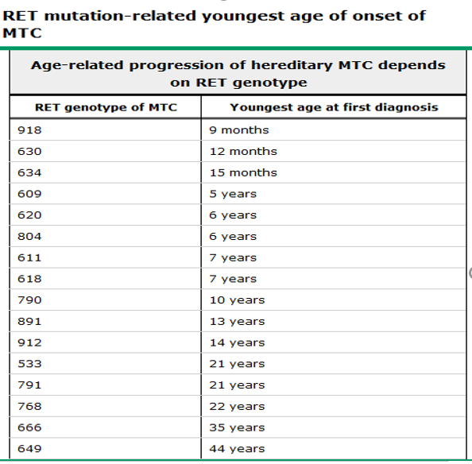
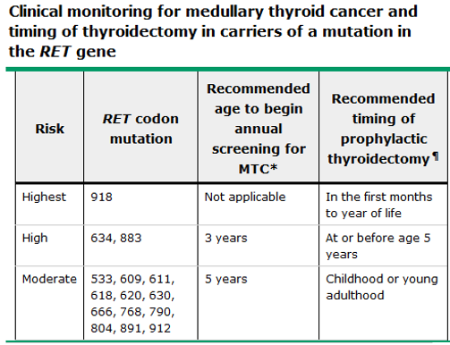

Slide 37
References:
1. American Association of Clinical Endocrinology And AssociazioneMedici Endocrinologi, April 2021.
2. Thyroid Imaging Reporting and Data System (TI-RADS):Radiology: Volume 287: Number 1—April 2018 radiology.
3. Management Guidelines for Children with Thyroid Nodules and Differentiated Thyroid Cancer, THYROID,Volume 25, Number 7, 2015, American Thyroid Association.
4. Thyroid nodules and cancer in children ,Uptodate ,Literature review current through: Oct 2021.

