Slide 3
Setila Dalili, M.D. Pediatric Endocrinologist

Slide 6
Screen
TSH IN OUR COUNTRY CAN MISS CENTRAL HYPOTHYROID
T4 , TSH IN OTHER COUNTRY FOR EVALUATION CENTRAL
INCIDENCE CENTAL HYPO 1/16000 -50000 . WE RECOMMENDED ADDING T4 OR FT4 TO TSH
BUT IN OUR COUNTRY IT ISNT COST EFFECTIVE

Slide 7
we recommend endocrine testing in
all neonates with a familial history of central CH
signs or symptoms of congenital hypopituitarism, for example, micropenis with undescended testes, hypoglycemia, prolonged jaundice, or unexplained failure to thrive.
dysmorphic ,Mid facial abnormality and cleft lip and plate .

Slide 9
POST SCREEN IN OUR COUNTRY
Prematurity (2,6,10 W)
Weight lower than 2500 gr
Weight >4000g
Twin and multiplication
Admitted to NICU or hospital
packed cell infusion or exchange therapy
Drug (dopamin, hydrocortisone, …)
TSH 5- 9.9 mIU/L
Improper blood sampling
cardiac malformation

Slide 12
consensus
false-negative neonatal screening
a high risk of mild CH not detected by neonatal screening
premature, lowbirthweight, and sick babies
a post-screening strategy
including collection of a second specimen *10 to 14 days of age may be considered (1/+00
The initial screening in an affected twin may be normal; a second screening in same sex twins should be considered
Clinical suspicion of hypothyroidism, despite normal TSH in TSH-based screening programs, should prompt further evaluation for primary (rare cases of false-negative neonatal screening results)
central CH ,particularly in children with a family history of central
In patients with Down’s syndrome, we recommend measuring TSH at the end of the neonatal period (1/++0).
The nonaffected sibling of twins should be followed up for possible TSH elevation later in life (2/+00).

Slide 13
Second screening test
2 weeks after the first screening test
preterm birth <37 weeks
low birth weight < 2500g
very low-birth weight
LGA >4000g
GA >40 weeks
Admission to NICU
Non thyroidal illness
Current Opinion Endocrinologic Diabetes Obes 2020

Slide 14
Second screening test
Syndromes
Malformations
use of steroid during pregnancy
specimen collection within the first 24 hours of life
Multiple births

Slide 15
Second screening test
Maternal thyroid disease is considered a risk factor for a delayed TSH rise, hence requiring a second screening between days 15 -30 of life

Slide 16
Second screening test
TSH values at the first screening ranging 6.5-9.9 mIU/L
Maternal diabetes
Maternal treatment with amiodaron
Maternal/neonatal iodine exposure
Congenital heart disease
Dopamine administration
Steroid administration
Transfusion

Slide 17
Screening of neonates of mother with ATD
Newborn whose mother is receiving an
antithyroid drug.
T4 and TSH values return to normal within 1 to 3 weeks
AAP2006

Slide 18
When
2, 6 ,10 w
Or
2,(4-6)w

Slide 19
Screening of neonate with Down syndrome
Two week
Two month
Every 6-12 months till 3 years old

Slide 20
What's the mechanism of hypothyroidism in down syndrome?
Extra chromosome 21 results in genomic dosage imbalance of dosage-sensitive genes interfering with thyroid hormone production

Slide 21
Screening of Neonate with Hemangioma
Thyroid testing is required monthly until one year of age

Slide 22
National protocol

Slide 23
Normal variation of T4& FT4
Before 4 wk of age
T4= 10.7 ± 1.4ug/dl
FT4= 2.03± 0.3 ng/dl
After four weeks of life
T4=7-16 ug/dl
FT4= 0.8-2 ng/dl
One to four weeks
TSH= 1-6
Up to date 2020

Slide 25
National protocol

Slide 30
Normal range
Normal range free T4 (Based on gestational age )
1 weeks after birth | .0.8-2.6ng/dl

Slide 31
TSH غیر طبیعی پاشنه
اندازه گیری TSH و T4 و free T4 سرم در روز چهاردهم تولد
TSH<10 سرم
TSH> 20 سرم
در هرسنی
TSH بالای 20 درمان
2 هفته بعد TSH چک شود
درمان با لووتیروکسین با هر میزان
TSH
اگر به همین میزان افزایش یابد درمان می کنیم ولی اگر نرمال باشد طبق پروتکل کشوری در 6 و 10 فالو شود و تصمیم به درمان می گیریم
اگر Free T4 یا T4 پایین باشد
درمان
T4 یا FREE T4 پایین
2 هفته بعد مجددا چک شود
اگر TSH بالا و مساوی 10 باشد و FREE T4 پایین باشد
اگر TSH پایین 10 باشد و FREE T4 پایین باشد
درمان
با شک به سنترال هایپوتیروییدیسم ارجاع به متخصص غدد کودکان
T4 نرمال
هفته 4 و 6 و 10 مجددا چک کنیم
اگر در هر مرحله
6<TSH<10
Free T4 یا T4 نرمال
سرم10<TSH<20
T4 نرمال و TSH<6
پیگیری
ارجاع متخصص غدد
premature

Slide 32
DX and management
abnormal neonatal screening result
should be referred to an expert center (1/++0).
confirmatory testing (fT4 and TSH) (1/++0).
If the serum TSH concentration is >20 mU/L
With T4 low or without T4 start treatment
TSH concentration is 6–20 mU/L beyond the age of 21 days
we suggest to either start LT4 treatment immediately and retest, off-treatment, at a later stage, or
to withhold treatment but retest 1 to 2 weeks later and to re-evaluate the need for treatment (lack of evidence in favor or against treatment, this is an area of further investigation) (2/++0).
In countries or regions where thyroid function tests are not readily available, LT4 treatment should be started if filter paper TSH concentration is >40 mU/L (at the moment of neonatal screening; arbitrary threshold, expert opinion) (2/+00).

Slide 33
TSH>5 IN FILTER PAPER
EVALUATION OF SERUM T4,FT4,TSH
TSH>20 WITH FILTER PAPER IN LOW ECONOMIC STATE
TREATMENT
TSH>20
with or without
LOW FT4
TREATMENT
TSH 10- 20
FT4
LOW
FT4
NL
TREATMENT
CHECK TSH 2 WEEKS LATER IF WAS SAMEor hiher TREATMENT
TSH 6-10
FT4 LOW
FT4
N
EVALUATION CENTRAL HYPOTHYROID
TREATMENT BASE3ED ON CLINICIAN JUDJMENT or retesting and increasing trend of tsh start treatment
No TREATMEWNT
AND
FOLLOW UP
TSH<6

Slide 34
FT4<5PMOL/ L
<0.4 ng/dl
Treatment: 10-15 µg/kg
NL TSH
FT4 WNR
For age
Treatment: 5-10 µg/kg
FT4 (5-12 pmol/L)
0.4-0.8ng/dl
Treatment:10 µg/kg

Slide 35
Central hypothyroidism
FT4<5PMOL/ L
<0.4 ng/dl
Low or NL TSH
Treatment: 10-15 µg/kg
recommendation
FT4 (5-12 pmol/L)
0.4-0.8ng/d
Low or NL TSH
Treatment: 5-10 µg/kg
if suspicious to overtreatment: check T3 or FT3
specially if signs of thyrotoxicosis or FT4 is around or above ULN, assuming LT4 has not been administered just before blood sampling
If suspicious to under treatment: check T3 or FT3, when FT4 is around the LLN, particularly if TSH >1 Mu/L

Slide 36
Central hypothyroidism
Ruled out adrenal insufficiency
If can’t be ruled out
START GLUCOCORTICOID
1 µgr SYNACTIN after 0, 30, 60 min
CHECK CORTISOL
CORTISOL > 18

Slide 37
Central hypothyroidism
Evaluation genetic
Abnormality in ACTH
Continue GLUCOCORTICOID
1 µgr SYNACTIN 0, 30, 60 min
CHECK CORTISOL
CORTISOL > 18

Slide 38
Diagnosis and Management of Central Congenital Hypothyroidism
Peter Lauffer^{1†}, Nitash Zwaveling-Soonawala^{1†}, Jolanda C. Naafs¹, Anita Boelen² and A. S. Paul van Trotsenburg¹ Front. Endocrinol., 09 September 2021 |
Proposed diagnostics after an abnormal newborn screening result suggestive for central congenital hypothyroidism. ¹ suspicion of THOP: re-measure FT4 and TSH at term age, suspicion of NTI: measure (F)T3 ± rT3, re-measure FT4 and TSH at recovery; suspicion of transient central CH due to maternal Graves’ disease: measure TSHRAb and maternal thyroid function, and start thyroxine treatment when the newborn’s FT4 is too low. ACTH, adrenocorticotropic hormone; CH, congenital hypothyroidism; CPHD, combined pituitary hormone deficiency; FT4, free thyroxine; FSH, follicle stimulating hormone; GH, growth hormone; HC, hydrocortisone; HP, hypothalamic-pituitary; IGF-1, insulin-like growth factor 1; IGFBP3, insulin-like growth factor binding protein 3; LD, low dose; LH, luteinizing hormone; LT4, levothyroxine; MRI, magnetic resonance imaging; NBS, newborn screening; NTI, non-thyroidal illness; rT3, reverse triiodothyronine; T4, thyroxine; TBG, thyroxine binding globulin; TH, thyroid hormone; THOP, transient hypothyroxinemia of prematurity; TRH, thyrotropin releasing hormone; TSH, thyroid stimulating hormone; TSHRAb, TSH receptor antibodies. (A–C) refer to three scenarios of different outcomes of the work-up of central CH (see the Management section).

Slide 39
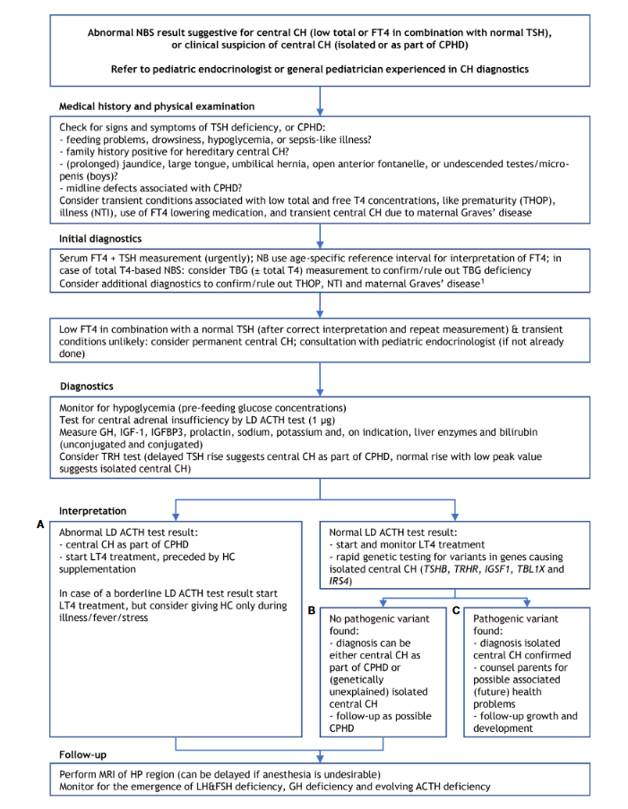

Slide 40
Abnormal LD ACTH test result:
*central CH as part of CPHD
*start lt4 treatment, preceded by HC supplementation
-In case of a border line LD ACTH test result start LT4 treatment, but consider giving HC only during illness/fever/stress
Normal LD ACTH test result:
-Start and monitor LT4 treatment
-Rapid genetic testing for variants in genes causing isolated central CH(TSHB, TRHR, IGSF1, TBL1X and IRS4)
No pathogenic variants found:
-diagnosis can be either central CH as part of CPHD or(genetically unexplained) isolated central CH
-follow-up as possible CPHD
Pathogenic variant found:
-diagnosis isolated central CH confirm
-counsel associated(future) health problems
-follow-up growth and development
MRI

Slide 42
Monitoring treatment in primary CH
We recommend measurement of serum fT4 and TSH concentrations before or at least 4 hours after the last (daily) LT4 administration
The first clinical and biochemical follow-up evaluation should take place 1 to 2 weeks after the start of LT4 treatment (1 week at the latest in case of a starting dose of 50 lg per day or an even higher dose)
Subsequent (clinical and biochemical) evaluation should take place every 2 weeks until complete nor- malization of serum TSH is achieved; therafter, the evaluation frequency can be lowered to once every 1 to 3 months until the age of 12 months

Slide 43
Stop in 2- 3y
Evaluation HPT in 2-3years in children without dfenitive diagnosis of permenant CH or with GIS and presumed isolated central CH
Stop in 2… 3 y
tsh very higher than 10 ..start tretment but tsh smaLer than refrence range and free t4 lower than normal range should be evaluated other anterior pituiary
Stop levo 1n 6m
n children with no permnant CH required lower than 3 microgr / kg levothyroxin in first 6 m of birh can be stoped levothyroxin in 6 m and reevaluated this patients

Slide 44
نوزاد14روزه ای پرماچور30 هفته با وزن1400 گرم با تست تیروئید زیر در بخش نوزادان با ازمایشات زیر با ما مشاوره داده شده است برای بیمار چه اقدامی می کنید
Free T4=0.5ng /dl ( 0.8 to 2.6 )
TSH=1miu/l
T4 =2mcg/ dL (7.7 ± 2.7 )
چون free t4 پایین است دو هفته بعد مجددا چک می کنیم اگر مجددا پایین بود و TSHهمچنان زیر 10 بود با شک به سنترال هایپوتیروییدیسم زیر نظر فوق غدد درمان شود ولی اگرنرمال بو د بر اساس پروتوکل کشوری بیمار را پی گیری می کنیم

Slide 45
نوزاد14روزه ای ترم با وزن3400 گرم با تست تیروئید زیر در بخش نوزادان با ازمایشات زیر با ما مشاوره داده شده است برای بیمار چه اقدامی می کنید
Free T4=0.5ng /dl ( 0.8 to 2.6 )
TSH=1miu/l
T4 =2mcg/ dL (7.7 ± 2.7 )
چون free t4 پایین است با شک به سنترال هایپوتیروییدیسم زیر نظر فوق غدد درمان شود

Slide 46
نوزاد هجده روزه‌ای با سن حاملگی 32 با تست تیروئید زیر ارجاع شده است نظر شما چیست
Free T4=1.5ng /dl 0.8 to 2.6
T4 =7mcg/ dl (9.1±3.6 (
TSH=12miu/l
چه درمانی برای این بیمار توصیه می کنید؟

Slide 47
نوزاد هجده روزه‌ای ترم با تست تیروئید زیر ارجاع شده است نظر شما چیست
Free T4=1.5ng /dl 0.8 to 2.6
T4 =7mcg/ dl (9.1±3.6 (
TSH=12miu/l
چه درمانی برای این بیمار توصیه می کنید؟

Slide 48
اگر در طول درمان کودک هیپوتیرویید T4 از بالای نرمال بیشتر باشد ولی TSH در محدوده نرمال باشد وبیمار علایم تیرو توکسیکوزیس ندارد چه درمانی توصیه می کنید
با همان دوز دارو را ادامه میدهیم

Slide 49
Recommendation
Recommendation
Starting t4 treatment before imaging
Recommendation
Imaging (sono ,radioisotope scaning with or without perchlorate)
Recmendeation
Knee x ray (severity intra uterin hypothyroidy)

Slide 50
Recommendation
Recommendation
Higher TSH(dysmorphic and congenital malformation :cardiac) and given lower dose of levothyroxine)
Recommendation
Any reduction of the levothyroxine should not be based on a single higher than normal ft4 concentration unless TSH IS SUPPRESD
Recmendeation
Higher levo in pregnant CH
TSH <2.5 IN Pregnant CH
INGESTION 250 MICGR IODINE PER DAY

Slide 51
Recommendation
Recommendation
Recommendation
Evaluation nodule with FNA for R/O cancer
Recmendeation
Intra aminiotic T4 Injection in euthyrid pregnant woman with a large fetal goiter with hydroaminos or tracheai oculation
Tsh should be lowerd in goiter (dyshormogenesis)

