Slide 1
Comorbidities of obesity
A.Yaraghi MD
Assistant Professor of Gastroenterology and hepatology
Shahid beheshty university of medical science

Slide 2
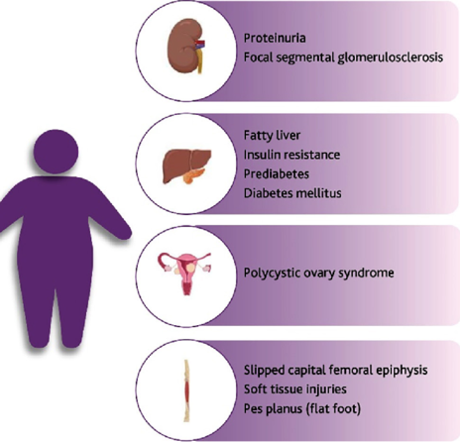
As the obesity epidemic continues to worsen, pediatric care providers must transition from assessing for future risk of weight-related comorbidities to the detection and treatment of them.
The review of systems should focus on symptoms of potential comorbidities.

Slide 3
The degree of obesity does not reliably predict the presence of comorbidities, and many of the symptoms may be unrecognized as related to weight status by the family

Slide 4
Respiratory
Symptom:
Shortness of breath, exercise intolerance, wheezing, cough
Explanation:
Asthma, aerobic deconditioning

Slide 5
Gastrointestinal
1)Vague recurrent abdominal pain
Nonalcoholic fatty liver disease
2) Heartburn, dysphagia, regurgitation, chest or epigastric pain
Gastroesophageal reflux
3) Abdominal pain or distension, flatulence, encopresis, anorexia, enuresis
Constipation
4)Right upper quadrant or epigastric pain, vomiting, colicky pain
Gallbladder disease, gallstones

Slide 6
Cardiovascular
Cardiovascular disease risk factors (hypertension, hypertriglyceridemia) are markedly higher in youth with obesity
elevated BMI increases the risk that high blood pressure will persist into adulthood.

Slide 7
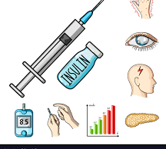
Endocrine
1)Polyuria, polydipsia
Type 2 diabetes mellitus
2) Amenorrhea, oligomenorrhea, or menorrhagia
Polycystic ovary syndrome

Slide 8
Orthopedic
1)Hip, knee, groin or thigh pain, painful gait
Slipped capital femoral epiphysis
2) Knee pain
Slipped capital femoral epiphysis or Blount disease
3) Foot pain
Increase weight bearing,pes planus

Slide 9
Genitourinary
1)Nocturia, nocturnal enuresis
Disordered sleep

Slide 10
Dermatology
1)Rash, irritated skin
Intertrigo
2) Darkened skin around neck and axilla
Acanthosis nigricans

Slide 11
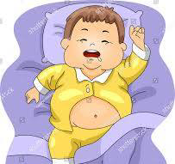
Sleep problem
1)Loud snoring, apnea, daytime sleepiness, restlessness, short attention span, behavioral problems
Obstructive sleep apnea, disordered sleep

Slide 12
Mental health
1)Flat affect, sad mood, loss of interest, worries
Body dissatisfaction, school avoidance, poor self-esteem
Depression, anxiety
2) Hyperphagia, binge eating, bulimia
Disordered eating

Slide 13
Weight-Related Comorbidity Assessment
Cardiac disease.
Lipid profile
Hyperlipidemia, hypertriglyceridemia, heart disease risk

Slide 14
Weight-Related Comorbidity Assessment
Hypertension
24-h ambulatory blood pressure monitoring
Complete blood count (CBC), metabolic panel, renin assay, urinalysis, renal ultrasound

Slide 15
Weight-Related Comorbidity Assessment
Fatty liver disease
Liver ultrasound; α1-antitrypsin, ceruloplasmin, anti-nuclear antibody (ANA), hepatitis antibodies
Liver biopsy

Slide 16
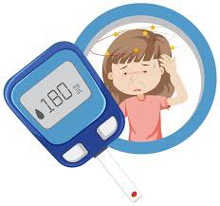
Weight-Related Comorbidity Assessment
Type 2 diabetes mellitus
Fasting glucose, glucose tolerance test, urinary microalbumin, hemoglobin (Hgb) A1c
Fasting glucose >125 mg/dL, Hgb A1c ≥6.5% indicative of diabetes; 100–125 mg/dL; Hgb A1c 5.7%–6.4% considered pre-diabetes

Slide 17
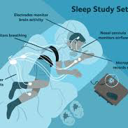
Weight-Related Comorbidity Assessment
Sleep apnea
Polysomnogram

Slide 18
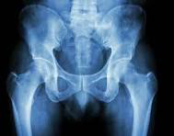
Orthopedic disease
Hip radiographs
Knee radiographs

Slide 19
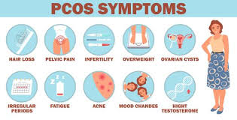
Polycystic ovary syndrome
17-OH progesterone, DHEAS, androstenedione, testosterone, LH, FSH, possibly pelvic ultrasound

Slide 20
Precocious puberty
LF, FSH, testosterone or estradiol, DHEAS

Slide 21
Pseudotumor cerebri
Funduscopic exam, lumbar puncture

Slide 22
Laboratory evaluation
extent of the laboratory evaluation of childhood obesity depends on the BMI
presence of risk factors
concerns arising from the history
Risk factors :
family history of obesity-related diseases
comorbidities in the patient
smoking

Slide 23
BMI of 85th–<95th percentile and no risk factors: fasting lipid levels
BMI of 85th–<95th percentile, with risk factors: fasting lipid levels, aspartate aminotransferase (AST) and alanine aminotransferase (ALT) levels, and fasting glucose level
BMI of ≥ 95th percentile: fasting lipid levels, AST and ALT levels, and fasting glucose level

Slide 24
Lipid evaluation
beginning at 2 years of age
dyslipidemia pattern:
mildly elevated low-density lipoprotein (LDL) cholesterol
moderate to severe elevation of triglycerides
depressed HDL cholesterol.

Slide 25
Thank you For your Attention

