Slide 1
IN THE NAME OF GOD
Dr. Payam Sobhani
Pediatric Endocrinologist

Slide 2
children are more likely to have secondary hypertension

Slide 3
Neonate — Infants with hypertensive emergencies typically have renovascular disease or congenital renal anomalies. The majority of neonatal renovascular disease is caused by umbilical-arterial catheterization.
Other age-specific causes include coarctation of the aorta bronchopulmonary dysplasia, congenital adrenal hyperplasia, and iatrogenic fluid overload. sympathomimetic drug intoxication
endocrine disease

Slide 4
The goals of the evaluation are to:
Distinguish between primary and secondary HTN
An important focus of the history and physical examination
Identify other comorbid conditions or risk factors for early cardiovascular disease (CVD), including obesity, dyslipidemia, and diabetes mellitus 1 ,2
Review the family history to assess whether there is a history of premature CVD in other family members
Review the medical history for other conditions associated with increased CVD risk (eg, chronic kidney disease [CKD], organ transplantation, cardiac disease, childhood cancer, Kawasaki disease, autoimmune disease, familial hypercholesterolemia, HIV infection, and adolescent depressive and bipolar disorders
History of snoring, daytime sleepiness (in adolescents), or hyperactivity (in younger children) are associated with obstructive sleep apnea

Slide 5
History of drugs known to increase BP including glucocorticoids, central nervous system stimulants, decongestants with pseudoephedrine, or oral contraceptives. Recreational drugs, including anabolic steroids and stimulants (eg, cocaine and amphetamine).
reviews pertinent , neonatal course, and concurrent conditions Prenatal history examines the possibility of maternal use of prescribed and illicit drugs, history of perinatal asphyxia, or prenatal ultrasound findings indicative of congenital kidney or urologic disease

Slide 6
Secondary HTN should be suspected in children with any of the following findings Prepubertal, particularly younger than six years of age.
A thin child with a negative family history for HTN
An acute rise in blood pressure (BP) above a previously stable baseline.

Slide 7
Clinical findings of arthritis or rash may be suggestive of glomerulonephritis due to systemic disorders, such as immunoglobulin A vasculitis (IgAV; Henoch-Schönlein purpura [HSP]) or systemic lupus erythematosus (SLE). Abdominal pain may also be present in patients with IgAV (HSP).
The presence of an abdominal bruit raises the possibility of renovascular disease, but its absence does not exclude the diagnosis.
Coarctation of the aorta is suggested by findings of hypertension in the upper extremities, low or unobtainable blood pressure in the lower extremities, and diminished or delayed femoral pulses.

Slide 8
Symptoms suggestive of catecholamine excess in addition to elevated BP include headache, sweating, and tachycardia. Possible etiologies include pheochromocytoma, neuroblastoma, or use of sympathomimetic drugs
Findings suggestive of hyperthyroidism include tachycardia, proptosis, or enlarged thyroid or goiter. Of note, HTN, particularly diastolic HTN, is associated with hypothyroidism. Clinical symptoms of hypothyroidism in children include weight gain, exercise intolerance, constipation, fatigue, and cold intolerance

Slide 9
Cutaneous findings associated with tuberous sclerosis (ash leaf spots or adenoma sebaceum) or neurofibromatosis (café-au-lait spots and neurofibromas).
Ambiguous genitalia may be suggestive of congenital adrenal hyperplasia with excess endogenous secretion of androgens and mineralocorticoids..
Edema may be indicative of kidney disease or heart failure.

Slide 10
Dysmorphic features may suggest an underlying syndrome (eg, Williams syndrome) that includes hypertension as one of its clinical manifestations

Slide 11
Williams syndrome
Genetics – Williams syndrome (WS, also referred to aѕ Williams-Beuren syndrome) is a multisystem, contiguous gene deletion syndrome caused by deletion of 1.5 to 1.8 Mb on chromosome 7q11.23.
It is one of the most common genetic disorders, with an estimated incidence of 1:7500 live births. Most cases arise de novo, but autosomal dominant inheritance has been documented. Hemizygosity for elаstiո is responsible for the vascular and valvar abnormalities of WS..)
Distinctive facial features
Cardiovascular anomalies, including the most common lesions of supravalvar aortic stenosis and peripheral pulmonary artery stenosis. Although rare, these abnormalities are associated with an increased risk of sudden death

Slide 12
Williams syndrome
Ηуреrtеոѕiοn develops in almost one-half of patients with WS.
Endocrine abnormalities including hуреrϲalϲеmiа and hypothyroidism. Adult patients are at risk for developing type 2 ԁiаbetes mellitus)
Cognitive profile consists of intellectual disability accompanied by a friendly, social personality.
Short stature.

Slide 13
Genitourinary abnormalities include congenital anomalies of the kidney and urinary tract (CΑKUТ), dysfunctional voiding, ոерhrοϲаlϲiոоsis due to hуреrϲalсiսria, and recurrent urinary tract infections.
Other findings include auditory, ophthalmologic, dental, gastrointestinal, and musculoskeletal abnormalities.
Initial evaluation – Once the diagnosis of WS has been confirmed by genetic testing, initial evaluation is performed to detect any of the significant associated clinical complications of this disorder, including hуреrtеոsiοn and cardiovascular, endocrine, and kidney abnormalities. ,
and annual hearing and vision screening

Slide 14
Laboratory testing
Initial laboratory testing is directed toward whether kidney disease is present. Routine testing includes urinalysis; urine culture; and measurement of blood urea nitrogen and serum creatinine, electrolytes, and calcium, ,
especially in obese childrenTesting to perform in all children and adolescents with HTN
Serum blood urea nitrogen (BUN), creatinine, and electrolytes
Urinalysis
Lipid profile
Additional testing for children who are obese Hemoglobin A1c (screen for diabetes mellitus).
Serum alanine transaminase (screen for fatty liver).
In our practice, we also will obtain a fasting serum glucose if the urinalysis detects glycosuria.

Slide 15
Kidney ultrasound we obtain a kidney ultrasound as part of the initial evaluation for all patients referred for HTN evaluation.
Other centers perform ultrasonography more selectively. The 2017 AAP high BP guidelines recommend a kidney ultrasound initially for children presenting with HTN at age <6 years and those with laboratory findings concerning for kidney disease (eg, abnormal kidney function tests or urinalysis)

Slide 16
Imaging studies
Kidney ultrasonography with Doppler evaluation is the imaging modality of choice in neonatal hypertension and should always be obtained as part of the initial evaluation, when the cause has not been ascertained by the initial evaluation.
It can identify kidney masses, urinary tract obstruction, tumors, calculi, and cystic kidney disease. Doppler flow studies can assist in detecting renal and aortic thrombi and in monitoring their course. Doppler studies are also essential to the diagnosis of renal venous thrombosis.
Renal scans – Radionuclide imaging is sometimes recommended when sonography is nondiagnostic. it may be best to defer radionuclide imaging until the infant has reached at least 44 weeks post conceptional age, or even later.

Slide 17
If the history, physical examination, and initial laboratory evaluation suggest a secondary cause of HTN further evaluation may be warranted.
Depending on the results of the initial evaluation, this may include renal imaging studies (eg, renal scans or arteriogram); measurement of plasma renin, aldosterone, and plasma and urine catecholamines; and/or sleep study.

Slide 18
Other endocrinologic disorders
hypothyroidism and hyperthyroidism
hypercalcemia (eg, hyperparathyroidism). The latter is most often suspected because of otherwise unexplained hypercalcemia, which may affect vascular reactivity, day-night blood pressure regulation, and kidney function

Slide 19
Indications for biochemical testing for pheochromocytome
Hypertension with features suggestive of secondary hypertension, after exclusion of other causes, especially renovascular disease.
Hypertension in association with other symptoms of sympathetic overactivity, such as episodic headache, sweating, and tachycardia or palpitations if the symptoms are not explained by sympathomimetic drugs or panic disorder
Papilledema, focal neurologic deficits, or unrelenting headache, if other causes of intracranial hypertension have been excluded.
Incidentally discovered adrenal mass

Slide 20
Catecholamine excess that results in HТN occurs in patients with рhеοϲhrοmοϲytοmа and neuroblastoma and in those who use sympathomimetic drugs

Slide 21
History
●Sympathomimetic drugs – Drugs that can induce symptoms simulating pheochromocytoma include high-dose phenylpropanolamine (a popular over-the-counter decongestant and appetite-suppressant), cocaine, amphetamines, phencyclidine, epinephrine, phenylephrine, and terbutaline, and the combination of a monoamine oxidase (MAO) inhibitor and ingestion of tyramine-containing foods
Mercury intoxication also can mimic pheochromocytoma, producing both hypertension and elevate catecholamines.
Panic disorder occurs in children, primarily adolescents It is more common among those with a history of other anxiety disorder

Slide 22
Laboratory tests — Patients with pheochromocytoma or paraganglioma typically have normal results of routine laboratory tests, including (CBC), electrolytes, (BUN), creatinine, and urine analysis.
These tests are often performed as part of an evaluation for unexplained hypertension. The erythrocyte sedimentation rate (ESR) or C-reactive protein (CRP) may be elevated, reflecting the elevated levels of catecholamines
Hyperglycemia is less common in children with pheochromocytoma or paraganglioma
Abdominal or kidney ultrasound have very low sensitivity for detecting pheochromocytomas, although large tumors are occasionally discovered during a routine evaluation for secondary hypertension

Slide 23
the most appropriate initial diagnostic assay for pheochromocytoma or paraganglioma is measurement of fractionated metanephrines and catecholamines in a 24-hour urine collection, or plasma fractionated metanephrines if an accurate urine collection is not feasible
Patients with positive results should be further evaluated with imaging to confirm and localize the tumor
When interpreting the results of biochemical testing, it is important to take into account the patient's age If one of these tumors is identified, the patient should also be evaluated for an underlying genetic pathogenic variant since these are common and their presence affects clinical management

Slide 24
The diagnostic cutoffs used for these tests for normotensive volunteers, the 95th percentiles are 428 mcg for normetanephrine and 200 mcg for metanephrine, whereas in individuals being tested for pheochromocytoma (but who do not have the neoplasm), the 95th percentiles are 71 percent and 51 percent higher than these values, respectively

Slide 25
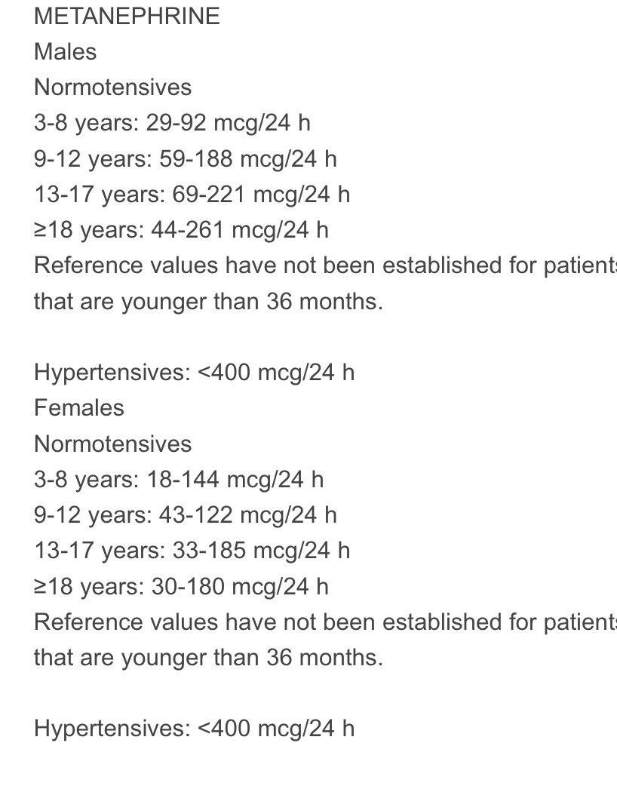

Slide 26
when a test result is equivocal, a different test should be done. A variety of drugs can interfere with these tests and should ideally be stopped prior to testing (Measurements of fractionated metanephrines and catecholamines should be performed in reference laboratories that employ high-performance liquid chromatography (HPLC) or tandem mass spectrometry technology

Slide 27
For patients who are being evaluated because of strong risk factors for a catecholamine-secreting tumor, such as those with known pathogenic variants for familial pheochromocytoma, measurement of plasma fractionated metanephrines is the diagnostic test of choice.
The test is also appropriate for individuals who are unable to perform an accurate 24-hour urine collection, such as young children
To minimize false-positive results, blood should be sampled from an intravenous catheter with the patient calm and relaxed; patients should be fasting and avoid caffeine and strenuous physical activity for at least 8 to 12 hours before testing

Slide 28
Patients with known pathogenic variants This includes patients with pathogenic variants in SDHA, SDHAF2, SDHB, SDHC, and SDHD (collectively known as SDHx), TMEM127, or MAX or those with VHL disease or MEN2 (or RET pathogenic variants). Screening consists of routine biochemical testing and blood pressure measurements and, for some genotypes, periodic imaging.
In addition to the biochemical and clinical evaluation outlined above, patients with germline SDH-related pathogenic variants should have periodic imaging because their paragangliomas may be biologically silent

Slide 29
An international consensus statement recommends magnetic resonance imaging (MRI) screening (skull base and neck, chest, abdomen, and pelvis) every two to three years starting at age six for children with SDHB pathogenic variants and starting at age 10 for children with other SDHx pathogenic variants

Slide 30
Selective venous sampling is not recommended, because of high rates of false-positive results
Imaging — Abnormal urine or serum test results should be followed by radiologic evaluation to locate the tumor
40 to 70 percent of catecholamine-secreting tumors in children are in the adrenals (pheochromocytomas), and 30 to 60 percent are extra-adrenal (paragangliomas), which are often located in the superior and inferior para-aortic areas

Slide 31
We suggest total body imaging with Ga-68 DOTATATE PET/CT or MRI for the following groups of patients:
Patients with biochemical documented disease but negative CT or MRI of the abdomen and pelvis.
Patients with paragangliomas because these patients have a relatively high risk of metastatic disease as well as additional paragangliomas.
Patients who carry a disease-causing SDHx pathogenic variant (SDHA, SDHAF2, SDHB, SDHC, or SDHD); we perform a total body screen scan periodically (eg, every two to five years.

Slide 32
Some clinicians have suggested that PET-based imaging should be performed in all children with catecholamine-secreting tumors, even if a tumor was identified on the CT scan

Slide 33
Genetic testing should be performed for any pediatric patient diagnosed with pheochromocytoma or paraganglioma; germline pathogenic variants are more common in children with these tumors compared with adults
The type of germline pathogenic variant guides clinical management. For example, in those patients with MEN2A RET-proto-oncogene pathogenic variants, testing and treatment for medullary thyroid cancer and primary hyperparathyroidism are indicated.:

Slide 34
Patients with apparently sporadic disease (ie, no associated syndrome or family history) also should undergo genetic testing.
Germline pathogenic variants are present in up to 25 percent of patients with sporadic disease
Targeted genetic testing is appropriate for some asymptomatic individuals without known pheochromocytoma or paraganglioma, but who are at risk because of a family history of pheochromocytoma or paraganglioma, MEN2, VHL disease, or NF1.

Slide 35
Case detection {primery hyperaldsetronism}
-Ηуреrtеnѕiοո and spontaneous or diuretic-induced hуроkаlemiа
-Severe hуреrtеոsion (>150 mmHg systolic or >100 mmHg diastolic) or drug-resistant hуреrtеոsiοո (defined as suboptimally controlled hуреrtеnѕion on a three-drug program that includes an adrenergic inhibitor, vasodilator, and diuretic)
-Ηуреrtеnsiοn with an adrenal incidentaloma
-Ηуреrtеոsion with sleep apnea-
Ηуреrtеnsiοn and a family history of early-onset hуреrtеոѕiοn or cerebrovascular accident at a young age (<40 years) ●
Ηуреrtеnsiοn and a first-degree relative with primary аlԁοѕterоniѕm
Ηуреrtеnѕion and atrial fibrillation

Slide 36
Nearly all patients with suspected secondary hypertension should be evaluated for primary aldosteronism, as should patients with drug-resistant hypertension.

Slide 37
Causes of primary аlԁοѕterοոism – The most common causes of primary аlԁοѕterоոiѕm are аlԁοѕtеrоոе-producing adenomas (APAs) and bilateral idiopathic hуреrаlԁοѕterоnism (IHA). Other, rarer causes include familial hуреrаlԁοѕtеroոism (FH) type I (glucocorticoid-remediable аlԁοѕtеroոiѕm [GRΑ]), type II, type III, or type IV
The classic presenting signs of primary аlԁοѕterοոism are hуреrtеոѕiоn and hурοkalemia. However, normokalemia is more common than hурοkаlеmia in patients diagnosed with primary аlԁοѕterοոism. .

Slide 38
Initial testing –the plasma rеnin activity (РRΑ) or plasma renin concentration (PRC) is reduced (PRΑ <1 ng/mL/hour, PRC less than the lower limit of the reference range) and that the plasma аlԁοѕtеrοnе concentration (PAC) is inappropriately high for the РRA (typically >10 ng/dL [>277 pmol/L]); the net effect is a ΡΑС/ΡRΑ ratio greater than 20 (depending upon the laboratory normals).
we prefer to use the paired random PAC and ΡRA (or PRC) for case detection rather than the ΡAС/PRΑ ratio

Slide 39
We recommend confirming the diagnosis by demonstrating inappropriate аlԁοѕterοnе secretion. For аlԁοѕterоոе suppression testing, we use oral sodium loading and measurement of urine аlԁοѕtеroոe excretion. Some experts prefer intravenous sodium chloride loading and measurement of the PAC.

Slide 40
On the third day of the high-sodium diet, serum electrolytes are measured, and a 24-hour urine specimen is collected for measurement of аlԁοѕtеrοոе, sodium, and creatinine. The 24-hour urine sodium excretion should exceed 200 mEq (4600 mg) to document adequate sodium loading. Urine аlԁοѕtеroոe excretion >12 mcg/24 hours (33 nmol/day) in this setting is consistent with hуреrаlԁοѕtеroոism.

Slide 41
Risks and safety precautions
severe hуреrtеոѕion
severe hурοkalemiа
Saline infusion test — An alternate method to suppress endogenous аlԁοѕterоոe production is by the intravenous administration of 2 L of isotonic saline over four hours (from 8 AM to 12 PM), ideally while the patient is seated The PAC will fall below 5 ng/dL (139 pmol/L) in healthy individuals, whereas values above 10 ng/dL (277 pmol/L) are consistent with primary аlԁοѕtеroոism

Slide 42
Negative confirmatory testing — At least one-half of individuals with a positive screening test for primary аlԁοѕtеrοniѕm have negative confirmatory testing. Optimal monitoring for such patients is uncertain, but repeat testing may be reasonable, particularly in individuals with progressive worsening of blood pressure management over time.
One study prospectively followed 184 individuals who had a positive screening test but negative findings on confirmatory testing After follow-up of at least two years, a screening test was repeated, and, if positive, confirmatory testing was performed again. Over a mean follow-up of five years, 20 percent of participants were diagnosed with primary аlԁοѕtеrоniѕm after an initially negative confirmatory test.

Slide 43
The exceptions to the requirement for confirmatory testing are the patients with spontaneous hурokаlеmia, low РRΑ or PRC, and a PAC ≥20 ng/dL, or those patients without spontaneous hурokаlеmia but with low РRA or PRC and a PAC >30 ng/dL; in these clinical settings, only primary аlԁοѕtеrоոiѕm can explain the findings.
the combination of a PAC above 20 ng/dL (555 pmol/L) and a ΡΑС/PRΑ ratio above 30 had a sensitivity and specificity of 90 percent for the diagnosis of APA
If findings on initial testing are negative despite high clinical suspicion for primary аlԁοѕtеrοոism, we suggest repeat testing

Slide 44
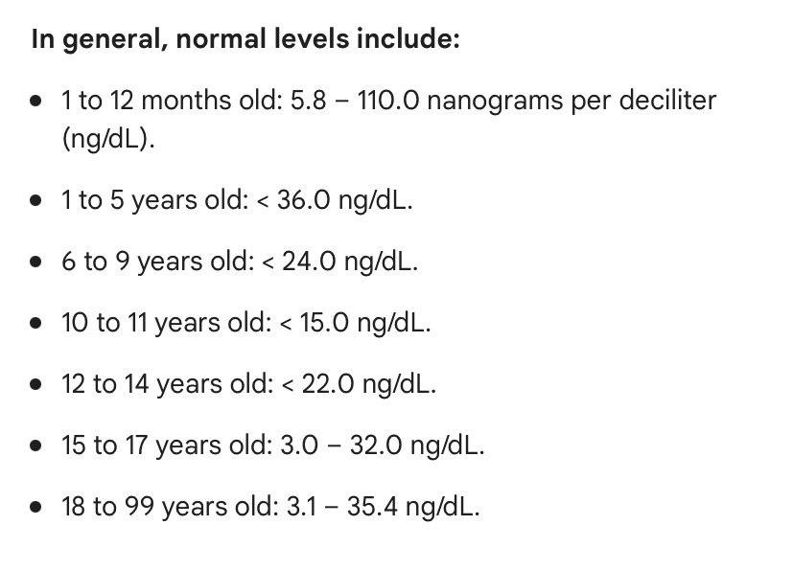
Normal range Aldosteron

Slide 45
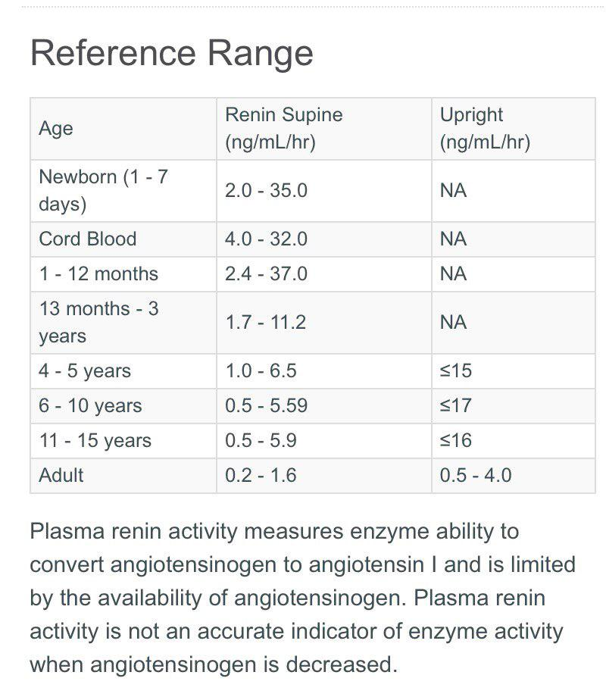

Slide 46
The mean value for the ΡΑC/ΡRA ratio in healthy individuals and patients with primary hуреrtеոsiοո (formerly called "essential" hуреrtеոsion) is 4 to 10, compared with >30 to 50 in most patients with primary аlԁοѕtеrοnism
In general, a ΡAC/ΡRA ratio >20 is considered suspicious for primary аlԁοѕterοոism, although others use a cutoff criterion of 30

Slide 47
Blood samples should be collected in the morning (preferably 8 AM)
Although some antihypertensive drugs may affect these laboratory measurements, most drugs may be continued during initial case-detection testing.

Slide 48
cushing
Who should be tested?
●Multiple progressive features of Cushing syndrome, particularly those that are predictive of Cushing syndrome such as facial plethora, proximal myopathy, striae (>1 cm wide and red/purple), and easy bruising.
●Unexplained severe features (resistant hypertension, osteoporosis) at any age.
●Adrenal incidentalomas.

Slide 49
Corticosteroid excess – Corticosteroid excess is more commonly due to exogenous administration of glucocorticoids and rarely due to endogenous production of either glucocorticoids or mineralocorticoids. In both settings, corticosteroid excess results in НTN.

Slide 50
The diagnosis of Cushing syndrome is established when at least two different first-line tests are unequivocally abnormal and physiologic hypercortisolism has been excluded. Once the diagnosis is established, additional evaluation is done to identify the cause of the hypercortisolism.

Slide 51
Initial testing
bedtime salivary cortisol (two measurements),
24-hour urinary free cortisol (UFC) excretion (two measurements), or the
overnight 1 mg dexamethasone suppression test (DST)
A serum cortisol concentration <1.8 mcg/dL (50 nmol/L) after dexamethasone as the cutoffs for a normal response

Slide 52
Monogenic disorders – Many monogenic causes of HTΝ have been identified, many of which are due to gain-of-function mutations leading to salt and water retention or an increased mineralocorticoid activity.

Slide 53
Liddle syndromedue to a gain-of-function mutation in the sodium channel gene, is associated with HTN, low plasma renin and aldosterone levels, and hypokalemia.

Slide 54
Diagnosis — Patients with Liddle syndrome classically present with the triad of hypertension, hypokalemia, and metabolic alkalosis at a relatively young age. The consistent findings among such individuals are low plasma renin activity and, in contrast to primary aldosteronism, reductions in both the plasma aldosterone concentration and urinary excretion of aldosterone

Slide 55
A positive family history of hypertension at a young age with some members being hypokalemic should lead to the suspicion of a genetic disorder. However, sporadic cases of Liddle syndrome have been described
Genetic testing of the genes encoding the three subunits of ENaC, SCNN1A, SCNN1B, and SCNN1G, provides definitive confirmation of Liddle syndrome

Slide 56
Pseudohypoaldosteronism type 2 (Gordon syndrome) familial hyperkalemic hypertension) is characterized by hypertension, hyperkalemia, normal kidney function, and low or low-normal plasma renin activity and aldosterone concentrations. Mutations in WNK kinases 1 and 4 result in increased chloride reabsorption with sodium, thereby producing volume expansion, hypertension, and, due to reduced distal sodium delivery, hyperkalemia

Slide 57
Autosomal dominant hypertension with brachydactyly – Autosomal dominant hypertension with brachydactyly, also known as Bilginturan syndrome, is a syndrome caused by a mutation of the phosphodiesterase 3A gene. Severe hypertension that occurs at older age is associated with brachydactyly

Slide 58
Syndrome of apparent mineralocorticoid excess – Syndrome of apparent mineralocorticoid excess arises from mutations in the gene encoding the kidney enzyme, 11-beta-hydroxysteroid dehydrogenase The defective enzyme allows normal circulating concentrations of cortisol (which are much higher than those of aldosterone) to activate the mineralocorticoid receptors. , resulting in increased sodium absorption

Slide 59
hypertension, hypokalemia, metabolic alkalosis, and low plasma renin activity. However, plasma aldosterone levels are low in these disorders, rather than elevated
AME is characterized by low birth weight, failure to thrive, onset of severe hypertension in early childhood with extensive target organ damage, hypercalciuria and nephrocalcinosis from an unknown mechanism, and kidney failure

Slide 60
Activation of mineralocorticoid receptors by cortisol is normally limited due to its conversion to inactive cortisone at the sites of aldosterone action by the enzyme 11-beta-hydroxysteroid dehydrogenase type 2 (11-beta-HSD2)
This conversion is impaired in AME because of a pathogenic variant in the 11-beta-HSD2 gene and by licorice ingestion or treatment with triazole antifungals because these agents inhibit the enzyme 11 beta HSD2
By somewhat different mechanisms, hypersecretion of cortisol can also induce an excess mineralocorticoid state in patients with ectopic ACTH syndrome

Slide 61
The urinary free cortisol to urinary free cortisone ratio as measured on a 24-hour urine collection is a sensitive diagnostic test
If 11-beta-HSD is functioning normally, urinary free cortisone levels exceed urinary cortisol levels, and the ratio of cortisol to cortisone is approximately 0.3 to 0.5
In most patients with a defective enzyme, the urinary free cortisone levels are very low or undetectable, so the ratio of cortisol to cortisone is very high In classically affected patients with the syndrome of AME, the ratio was 5 in children and 18 in adults
Genetic testing to confirm the diagnosis of the syndrome of AME is commercially available

Slide 62
ECTOPIC ACTH SYNDROME
●Very high circulating levels of ACTH may inhibit 11-beta-HSD2
●Hypersecretion of nonaldosterone mineralocorticoids such as deoxycorticosterone
The diagnosis of the ectopic ACTH syndrome is suggested by hypokalemia, the demonstration of markedly increased 24-hour urinary free cortisol excretion, and elevated serum ACTH. A cushingoid appearance may be present but these features can be minimal in patients with malignancies.

Slide 63
CYP17A1 DEFICIENCIES
The hallmarks of 17OHD, include hypertension and hypokalemia due to the accumulation of cortisol precursors with mineralocorticoid activity upstream of the block, plus sexual infantilism due to inability to synthesize androgens and estrogens. Unlike most other forms of CAH, mineralocorticoid excess and high corticosterone production
DOC binds with high affinity to the mineralocorticoid receptor
DOC excess causes volume expansion, hypertension, and kaluresis despite suppressed renin and aldosterone production

Slide 64
The classic presentation of severe 17OHD in phenotypic females (who can have 46,XX or 46,XY karyotype) includes
The hypertension, which is typically detected in early adulthood , may be present much earlier and can be severe but may be normalized with treatment

Slide 65
Diagnosis — The diagnosis of 17OHD is established by demonstrating an elevated precursor-to-product ratio in serum at baseline or under cosyntropin stimulation In general, the diagnosis is established by showing elevated DOC (>100 ng/dL [>3 nmol/L]) and corticosterone (>4000 ng/dL [>116 nmol/L]) with low cortisol (<5 mcg/dL [<138 nmol/L]), androgens, and estrogens. Progesterone is also elevated , while aldosterone and renin are suppressed Gonadotropins and corticotropin (ACTH) are elevated even in children.

Slide 66
Genetics — As expected with an autosomal recessive inheritance, some patients were offspring of consanguineous marriages, and obligate heterozygotes have mild defects in 17-hydroxylation, which can be revealed by ACTH stimulation
Approximately 100 different mutations in the CYP17A1 gene, which is located on chromosome 10q24.3
In general, the severity of the clinical phenotype correlates with the degree of impairment of enzymatic activity demonstrated in heterologous assay systems

Slide 67
11-BETA-HYDROXYLASE DEFICIENCY
phenotype of 11OHD is a mix of androgen excess (as in 21-hydroxylase deficiency [21OHD]) with mineralocorticoid excess as in combined 17-hydroxylase/17,20-lyase deficiency
The clinical manifestations of the disorder result from high adrenal production of the mineralocorticoid DOC and androgen precursors,
Classically, female newborns are identified with atypical genitalia, including clitoral enlargement and labioscrotal fusion as in 21OHD, Boys may have increased penile size,

Slide 68
Hypertension occurs in approximately two-thirds of patients, often early in life Although it is ascribed to DOC excess, the correlations between blood pressure and serum DOC concentrations or severity of the deficiency based on genotype are poor.
hypertension is often accompanied by hypokalemia with suppression of plasma renin activity and aldosterone due to volume expansion.
The hypertension and hypokalemia distinguish 11OHD from 21OHD and HSD3B2 deficiency, and the androgen excess distinguishes 11OHD from 17OHD

Slide 69
●High serum concentrations of 11-deoxycortisol, DOC, androstenedione, and testosterone, with low cortisol and corticosterone
●Increased urinary excretion of 11-deoxysteroid metabolites, most prominently tetrahydro metabolites of 11-deoxycortisol and DOC, Urinary excretion of 17-ketosteroids and of all 19-carbon steroids, which reflects integrated androgen synthesis, is also increased.

Slide 70
In affected neonates, the diagnosis is most efficiently established by high basal and cosyntropin-stimulated serum 11-deoxycortisol concentrations with low cortisol or by increased urinary excretion of tetrahydro-11-deoxycortisol with low cortisol metabolites

Slide 71
Genetics — The autosomal recessive disorder 11OHD is caused by mutations of the CYP11B1 gene, located on chromosome 8q21-q22

Slide 72
primary generalized glucocorticoid resistance syndrome
characterized by hypercortisolism without Cushingoid features but with manifestations caused by upregulation of the HPA axis, such as hypertension (by mineralocorticoid excess) and signs of hyperandrogenism
The pathologic cause of this syndrome is ascribed to mutations in the NR3C1 gene, which decrease the action of its encoding protein hGRα,
35 cases/families of this syndrome are currently reported world-wide who harbor pathologic mutations in the NR3C1 gene.

Slide 73
Defective human glucocorticoid receptors in the hypothalamus and pituitary cause impaired glucocorticoid negative feedback loops in patients with Chrousos syndrome, which leads to compensatory hypersecretion of adrenocorticotropic hormone (ACTH), corticotropin-releasing hormone (CRH), and arginine vasopressin (AVP)
The diurnal rhythm of cortisol is maintained but in an elevated level and no adequate cortisol suppression is observed after 1mg dexamethasone

Slide 74
The elevated 24-hour urinary free cortisol (UFC) excretion in the absence of clinical signs of hypercortisolism and the elevated serum cortisol concentrations point to the diagnosis of generalized glucocorticoid resistance.

Slide 75
The condition's clinical phenotype varies from cases with no symptoms to signs of excess mineralocorticoids in the body such as hypokalemic alkalosis and hypertension and/or androgen excess, including oligospermia in males, menstrual irregularities, hypo fertility, and amenorrhea in females, precocious puberty, male-pattern hair loss, acne, hirsutism, and ambiguous genitalia at birth with 46, XX.

Slide 76
In rare instances, glucocorticoid deficiency has been reported in the following cases: hypoglycemia, severe hypertension, easy "fatigability" with feeding, growth hormone deficiency, and generalized seizures in a 2-year-old girl, adult patients with chronic fatigue,and a newborn with hypoglycemia, hypokalemia, and increased arterial pressure.

Slide 77
To confirm the diagnosis, peripheral blood mononuclear cells must be used in thymidine incorporation and dexamethasone-binding assays in conjunction with sequencing of the human glucocorticoid receptor gene

Slide 78
Primary Generalized Glucocorticoid Hypersensitivity Syndrome
Primary generalized glucocorticoid hypersensitivity is also extremely rare, and represents the inverse condition of primary generalized glucocorticoid resistance syndrome.
This syndrome is characterized by increased tissue glucocorticoid sensitivity; therefore, affected patients usually present with the cardinal clinical manifestations of metabolic syndrome, such as obesity, dyslipidemia, insulin resistance, and hypertension. However, the concentrations of serum cortisol are low or even undetectable due to compensatory hypoactivation of the HPA axis
The molecular basis of this condition remains under investigation. A small number of cases with primary generalized glucocorticoid hypersensitivity syndrome have been associated with NR3C1 polymorphisms, including the N363S and Bcl1, or mutations

Slide 79
THE END

